Slide 1
e-Procurement Ontology
Publications Office – Unit C2
5th Working Group Meeting: 2018-03-28

Slide 2
Roll call
Glossary feedback (Natalie Muric)
Expectations from WG (Virginia Gomariz)
Conceptual Data Model (Enric Staromiejski)
Preparation of the PoC (Enric Staromiejski)
Any other business

Slide 3
Roll call
Glossary feedback (Natalie Muric)
Expectations from WG (Virginia Gomariz)
Conceptual Data Model (Enric Staromiejski)
Preparation of the PoC (Enric Staromiejski)
Any other business

Slide 4
2. Glossary feedback
No issues or feedback received about the Glossary
Are there any improvement points for the Glossary?
Are there any missing concepts and definitions?
Weekly meetings foreseen with the WG to verify glossary terms and definitions

Slide 5
Roll call
Glossary feedback (Natalie Muric)
Expectations from WG (Virginia Gomariz)
Conceptual Data Model (Enric Staromiejski)
Preparation of the PoC (Enric Staromiejski)
Any other business

Slide 6
3. Expectations from WG
Business feedback to improve the Glossary
Business and technical feedback about the Conceptual Data Model
Review of the approach about the Proof of Concept
Technical meetings with everis to progress on design and implementation topics

Slide 7
Roll call
Glossary feedback (Natalie Muric)
Expectations from WG (Virginia Gomariz)
Conceptual Data Model (Enric Staromiejski)
Preparation of the PoC (Enric Staromiejski)
Any other business

Slide 8
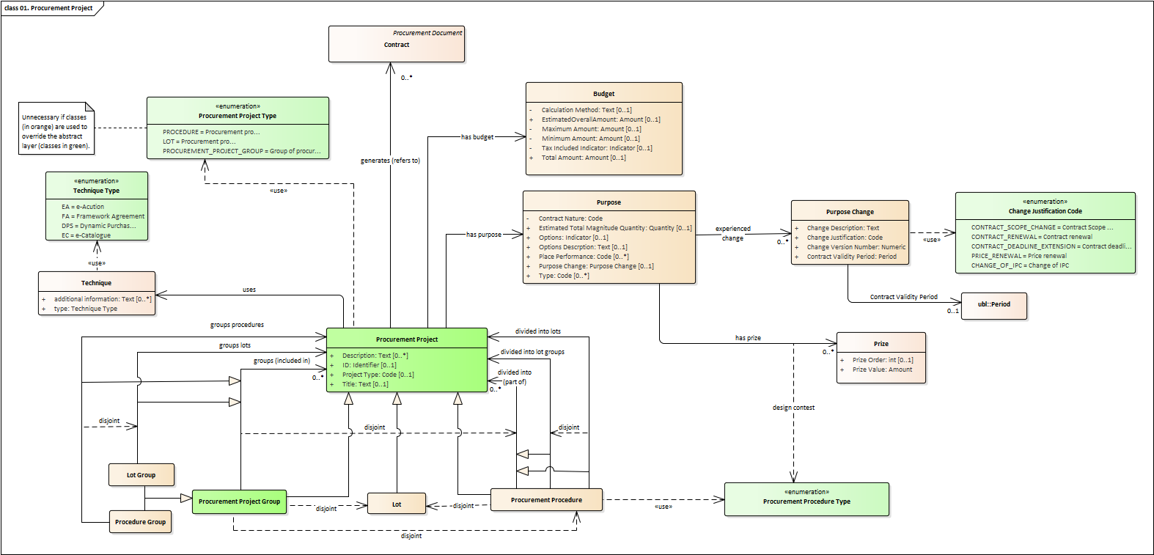
4. Conceptual Data Model
Objectives for the WG members:
Review completeness
Review coherence
Issue considerations on design aspects
→ Proposal: regular meetings with subgroup of technical experts
https://github.com/eprocurementontology/eprocurementontology/wiki/Conceptual-Model#classes-and-properties

Slide 9
Roll call
Glossary feedback (Natalie Muric)
Expectations from WG (Virginia Gomariz)
Conceptual Data Model (Enric Staromiejski)
Preparation of the PoC (Enric Staromiejski)
Any other business

Slide 10
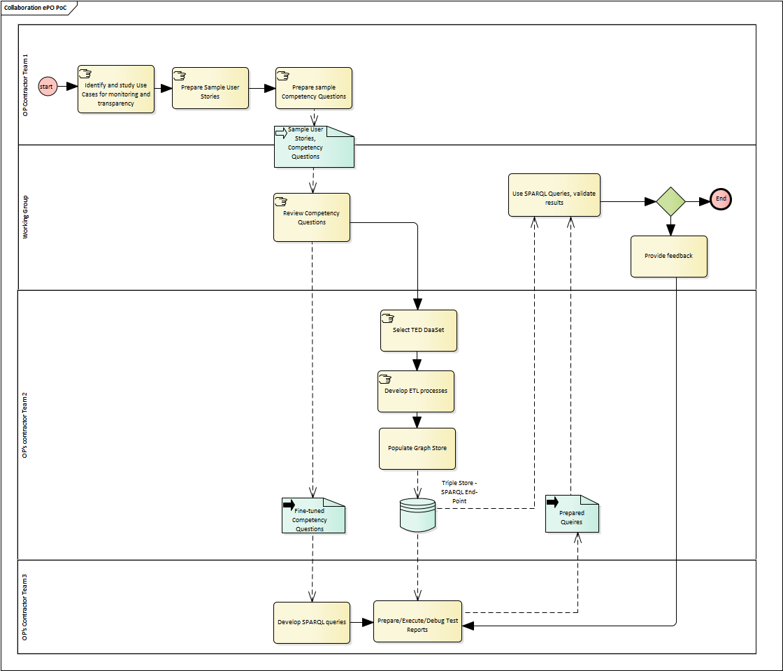
5. Preparation of the PoC
PoC Workflow
https://github.com/eprocurementontology/eprocurementontology/blob/master/v2.0.0/03_Analysis%20and%20design/img/ePO_PoC.png

Slide 11
5. Preparation of the PoC
CQ Methodology
1
Use Cases
User Stories
Competency Questions
Use case 1. Data journalism
Use case 4. Analyzing eProcurement procedures
e.g., as a journalist I want to know the contract value per year for tram maintenance at country level by selecting awards that refer to some CPV codes in order to compare it with other countries.
e.g., for a given CPV, the number of contracts awarded per year and per country for that CPV and the total value amount awarded.
2
3
https://github.com/eprocurementontology/eprocurementontology/blob/master/v2.0.0/02_IR_DED/WayforwardCompetencyQuestions.pdf https://github.com/eprocurementontology/eprocurementontology/wiki/Competency-Questions

Slide 12
5. Preparation of the PoC
19th April
First version of PoC available for revision by WG.
26th April
PoC final report available for comments by WG.

Slide 13
Roll call
Glossary feedback (Natalie Muric)
Expectations from WG (Virginia Gomariz)
Conceptual Data Model (Maria Font)
Preparation of the PoC (Enric Staromiejski)
Any other business

